Slide 1
Binary Search Tree

Slide 2
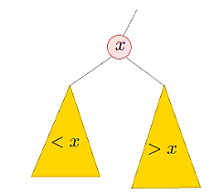
What is Binary Search Tree?
درخت جستجوی باینری یک ساختار داده درخت باینری است که دارای ویژگی های زیر است:
زیردرخت سمت چپ هر گره فقط شامل گره هایی با کلیدهای کوچکتر از کلید آن گره است.
زیردرخت سمت راست یک گره فقط شامل گره هایی با کلیدهای بزرگتر از کلید آن گره است.
زیردرخت چپ و راست هر کدام باید یک درخت جستجوی باینری باشند.
There must be no duplicate nodes!

Slide 3
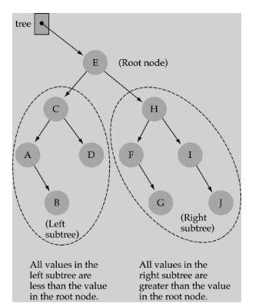
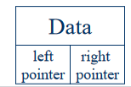
ویژگی های مطرح شده در اسلاید قبل، ویژگی هایBST نامیده می شود و جستجو، درج و حذف عناصر در درخت را به طور موثر امکان پذیر می کند.

Slide 4
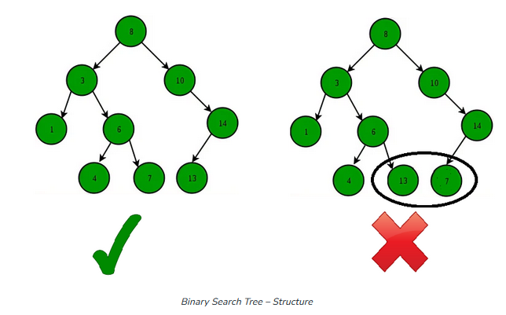

Slide 5
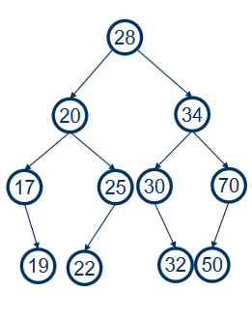
BST Traverse
Pre order: 28 20 17 19 25 22 34 30 32 70 50
Post order: 19 17 22 25 20 32 20 50 70 34 28
In order : 17 19 20 22 25 28 30 32 34 50 70
خروجی پیمایش میان ترتیب، درخت مرتب شده عناصراست!

Slide 6
کاربرد های درخت جستجوی دودویی
حذف عنصر تکراری در لیست ها
جستجو به دنبال داده ها
مرتب سازی(پیمایش میان ترتیب هرد.د.ج باعث نمایش عناصر درخت بصورت صعودی و مرتب می شود.)

Slide 7
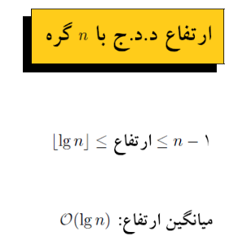
BST Height

Slide 8
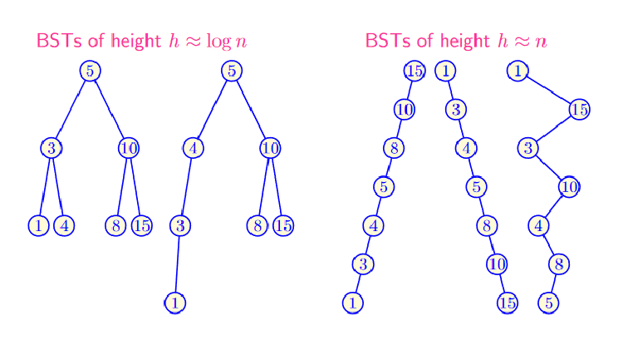
If a tree becomes skewed, the time complexity of search, insertion, and deletion operations will be O(n) instead of O(log n), which can make the tree inefficient.

Slide 9
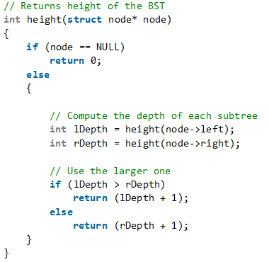

Slide 10
Search in BST
Time complexity: O(h), where h is the height of the BST.

Slide 11
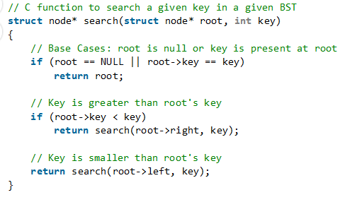

Slide 12
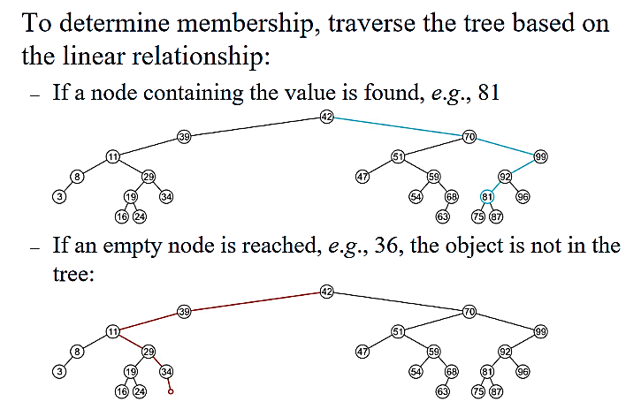

Slide 14
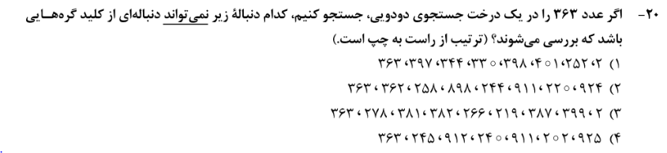
سوال کنکور دکتری 1402

Slide 15
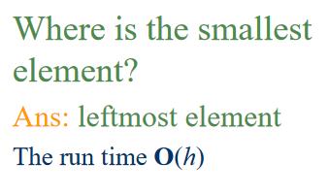
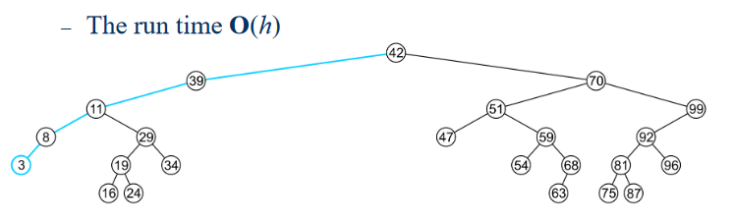
Minimum node in BST

Slide 16
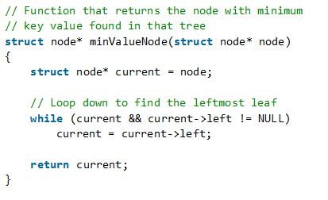

Slide 17
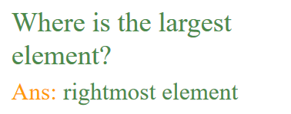
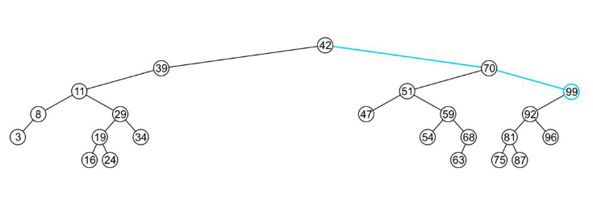
Maximum node in BST

Slide 18
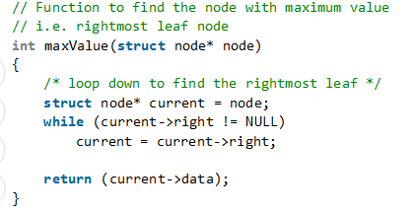

Slide 19
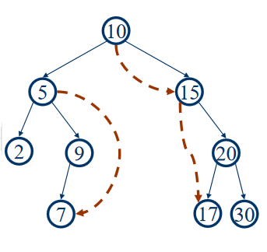
Successor Node in BST
Next larger node in this node’s subtree
In a Binary Search Tree, the Inorder Successor of a given node is defined as the node with the smallest value greater than the value of the given node

Slide 20
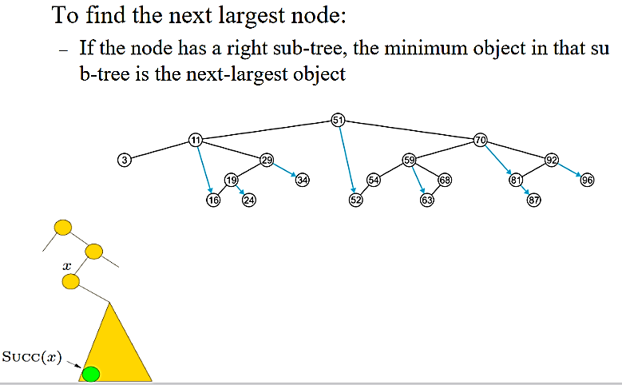
Successor Node in BST

Slide 21
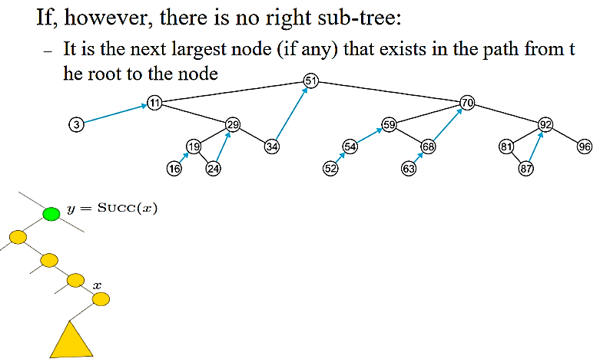
Successor Node in BST

Slide 22
Successor Node in BST
In this method, we assume that every node has a parent pointer.
If right subtree of node is not NULL, then succ lies in right subtree. Do the following. Go to right subtree and return the node with minimum key value in the right subtree.
If right subtree of node is NULL, then succ is one of the ancestors. Do the following. Travel up using the parent pointer until you see a node which is left child of its parent. The parent of such a node is the succ.

Slide 23
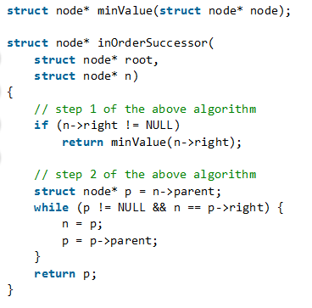

Slide 24
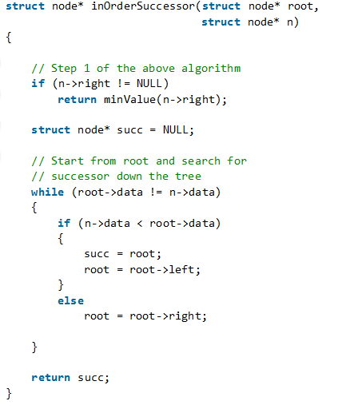
Without Parent pointer

Slide 25
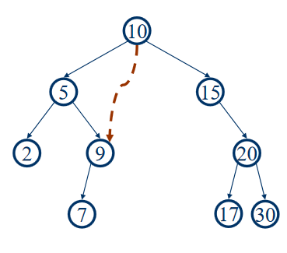
Predecessor Node in BST
Next smaller node in this node’s subtree
In a Binary Search Tree, the Inorder Predecessor of a given node is defined as the node with the largest value smaller than the value of the given node
?

Slide 26
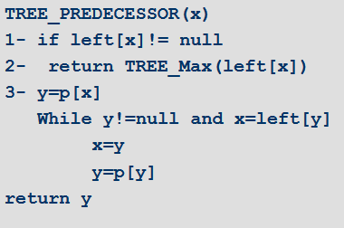
Predecessor Node in BST

Slide 27
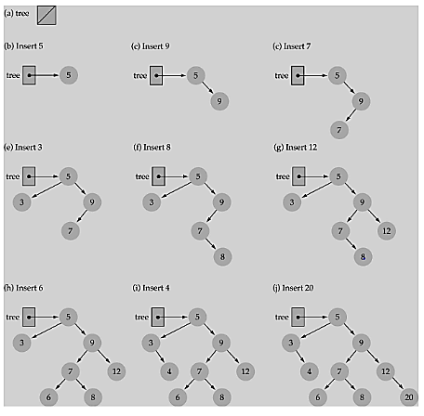
Insert in BST
از ویژگی درخت جستجوی باینری برای درج مورد جدید در محل صحیح استفاده کنید.

Slide 28
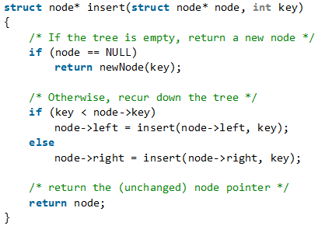

Slide 29
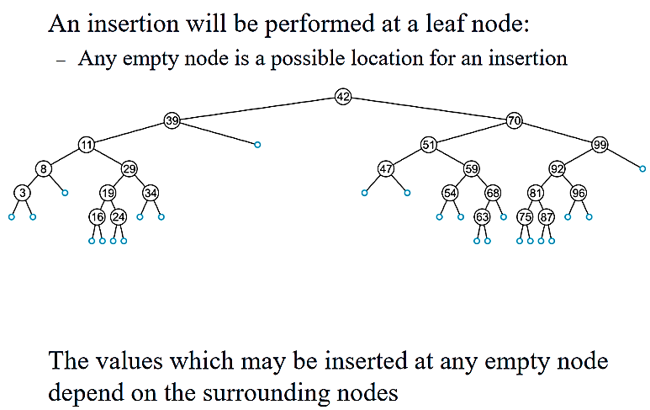

Slide 30
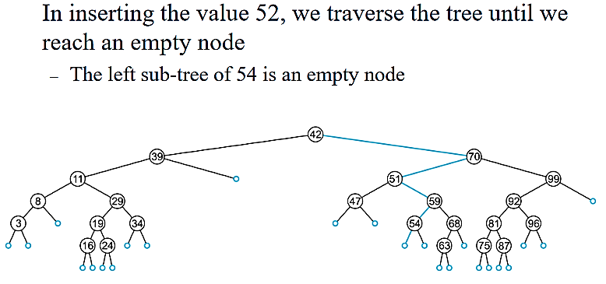

Slide 31
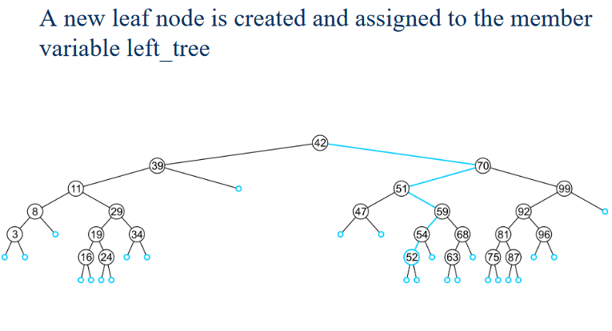

Slide 32
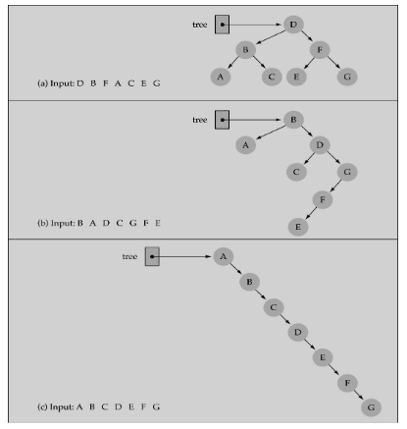
آیا ترتیب قرار دادن عناصر در درخت مهم است؟
بله، برخی ترتیبات ممکن است درختان بسیار نامتعادل تولید کنند!

Slide 33
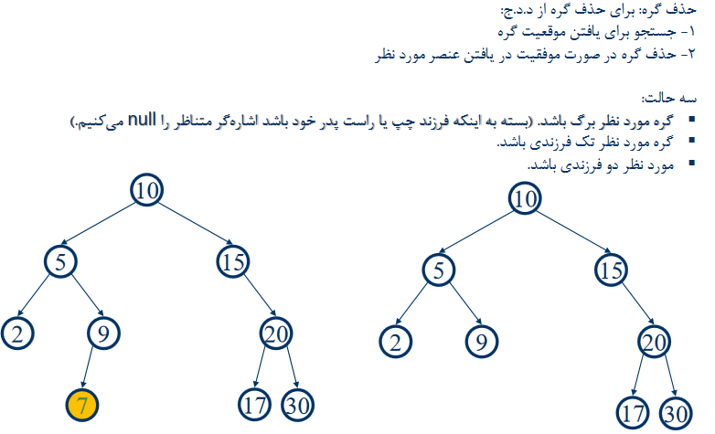
Deletion in BST
Deletion be harder than insertion

Slide 34
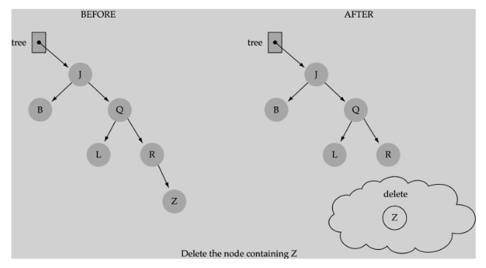
(1) Deleting a leaf

Slide 35
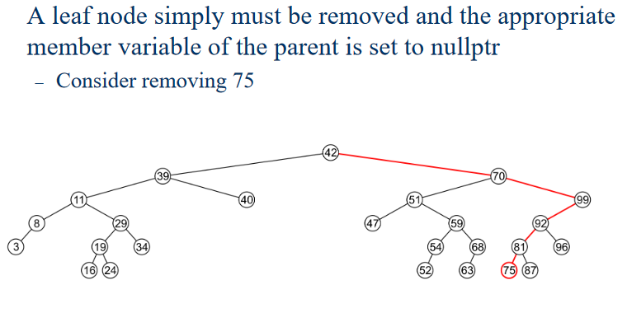
(1) Deleting a leaf

Slide 36
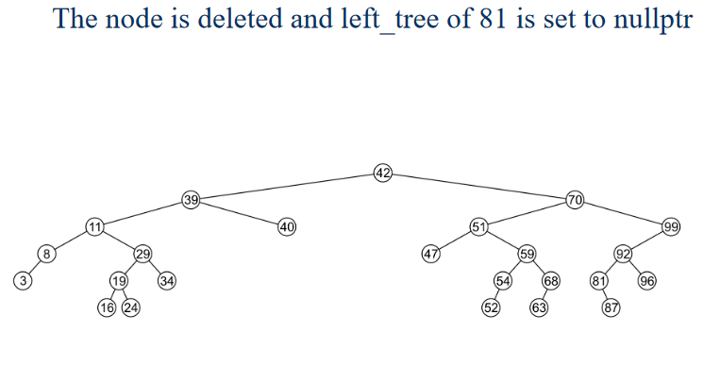
(1) Deleting a leaf

Slide 37
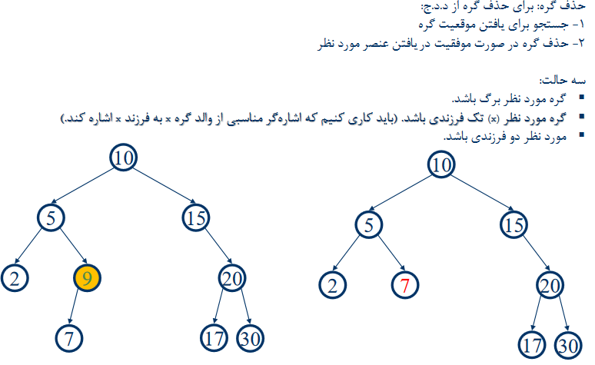
(2) Deleting a node with only one child

Slide 38
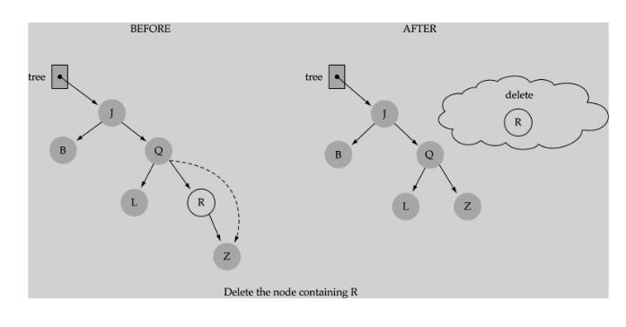
(2) Deleting a node with only one child

Slide 39
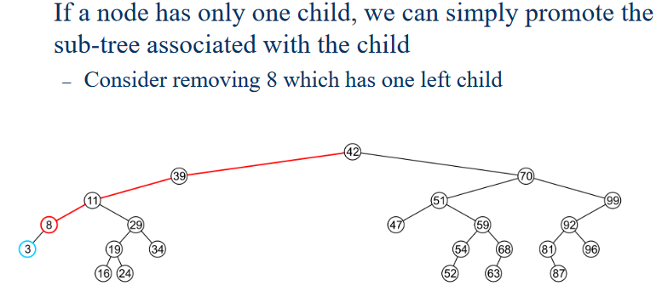
(2) Deleting a node with only one child

Slide 40
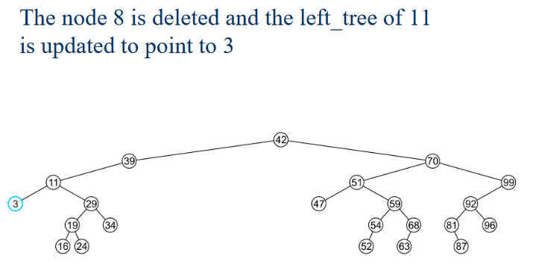
(2) Deleting a node with only one child

Slide 41
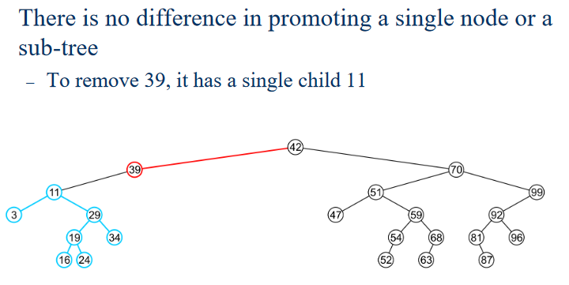
(2) Deleting a node with only one child

Slide 42
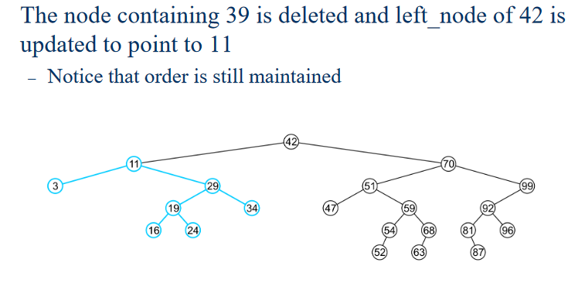
(2) Deleting a node with only one child

Slide 43
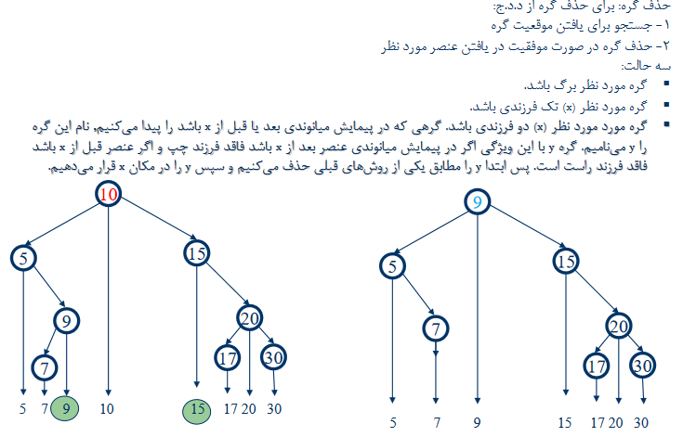
(3) Deleting a node with two children

Slide 44
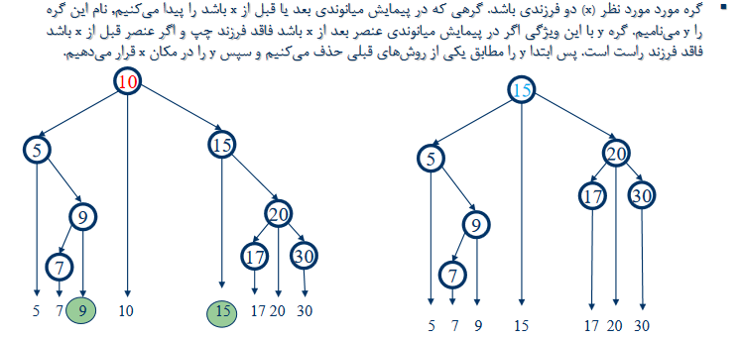
(3) Deleting a node with two children

Slide 45
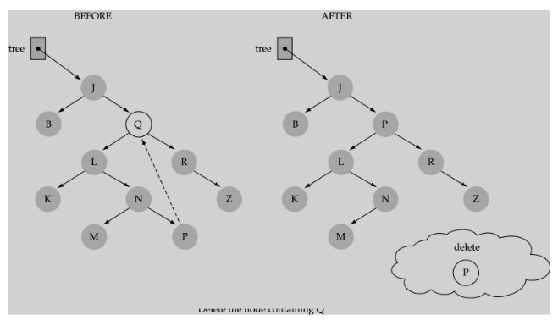
(3) Deleting a node with two children

Slide 46
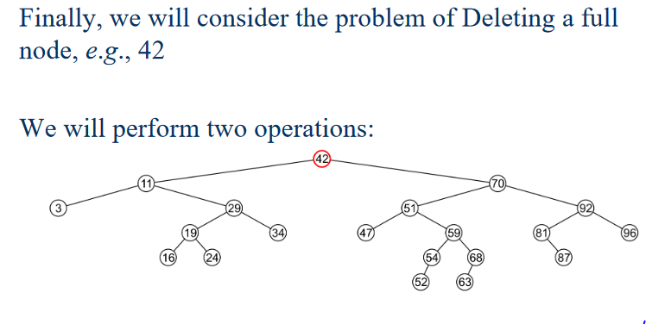
(3) Deleting a node with two children

Slide 47
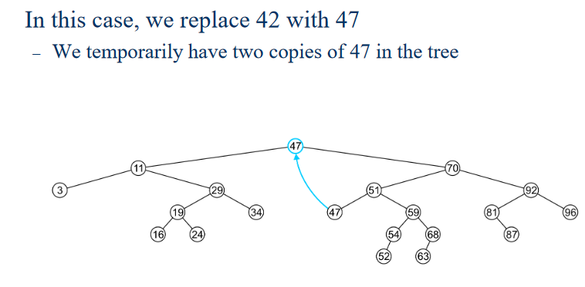
(3) Deleting a node with two children

Slide 48
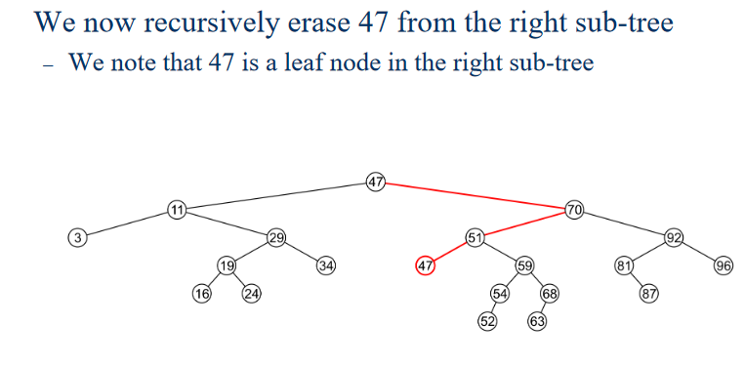
(3) Deleting a node with two children

Slide 49
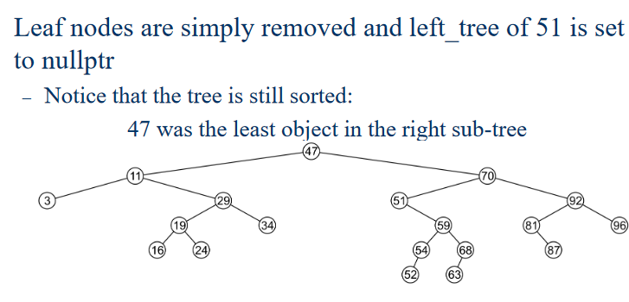
(3) Deleting a node with two children

Slide 50
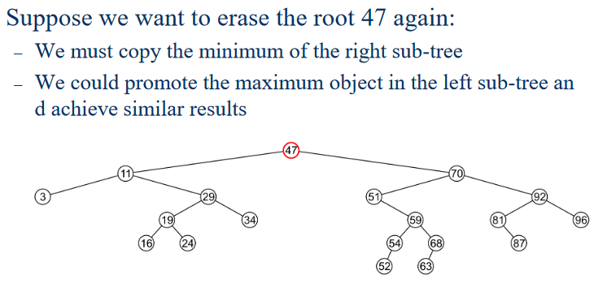
(3) Deleting a node with two children

Slide 51
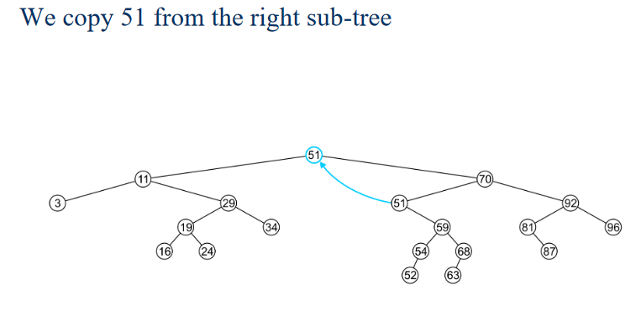
(3) Deleting a node with two children

Slide 52
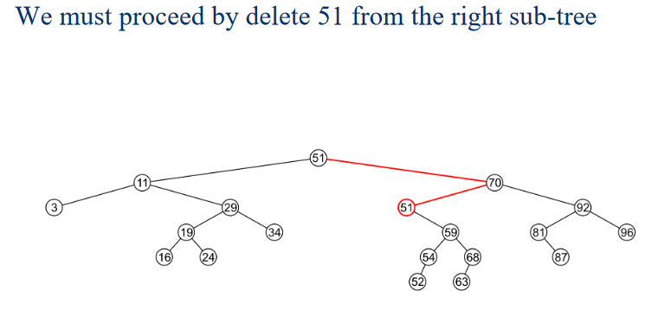
(3) Deleting a node with two children

Slide 53

(3) Deleting a node with two children

Slide 54

(3) Deleting a node with two children

Slide 55

(3) Deleting a node with two children
Note that after two removals, the remaining tree is still correctly sorted

Slide 56

(3) Deleting a node with two children
In the two examples of removing a full node, we promoted:

Slide 57

(3) Deleting a node with two children

Slide 58

(3) Deleting a node with two children

Slide 59
Convert a normal BST to Balanced BST
Given a BST (Binary Search Tree) that may be unbalanced, convert it into a balanced BST that has minimum possible height.
Traverse given BST in inorder and store result in an array. Note that this array would be sorted as inorder traversal of BST always produces sorted sequence.
Set The middle element of the array as root.
Recursively do the same for the left half and right half.
Get the middle of the left half and make it the left child of the root created in step 1.
Get the middle of the right half and make it the right child of the root created in step 1.
Print the preorder of the tree.

Slide 60


Convert a normal BST to Balanced BST

